Slide 1
E - CONSERVE
The Best Energy conservation methodology

Slide 2
TOC
Overview
Problem Statement
Project objective
Insights
Similar Products
Target audience
Solution Proposal
SWOT Analysis
Block Diagram 1 and Explanation
Circuit Diagram
Block Diagram 2 and Explanation
Calculation
Camera Specification
Implementation
Video Demonstration
Budget
Project Timeline
Conclusion
Appendix: Code

Slide 3
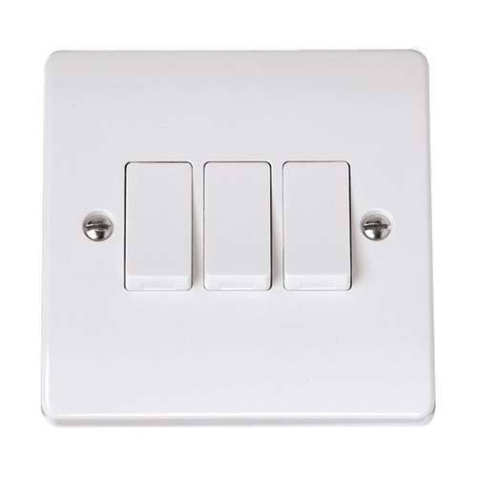
Overview
We may have came across many situations wherein we are confused in switching on particular fan or lights among different switches in a very large room.
Or we may have noticed appliances is on condition even though there are nobody sitting near it.
These are the problems, although simple but can be rooted to Increase in Energy Consumption,
It is more apparent in Large scale industries, schools, colleges and offices.

Slide 4
Problem Statement
By the survey of Times Of India , we came to know that about 90,000 unit of electrical energy gets wasted every year due to not switching off electrical appliances . Which in turn electricity bill . As we know that without electrical energy nothing can happen in this era . So it is very necessary to solve the above problem in this energy demanding society
Hence to solve the above problem we have proposed a solution called as E-Conserve

Slide 5
Project Objective
01
To design a solution which could prevent wastage of electrical energy
02
To automate switching of electrical appliances without need of searching for switches
03
To design a solution which could considerably reduce the electricity consumption and electricity bill
04
To design a user friendly and cost effective solution
05
To design a solution which gives low maintenance cost

Slide 6
Similar Products
Optimum Energy Management System Using IR
This system is designed to switch the home appliances (room lights in this case) on when a person enters in and leaves out of his room. The system also counts the number of persons entering and leaving the room and displays that information on LCD display.
This system possesses two sets of IR LED and IR sensors to detect the persons entering and leaving the room.

Slide 7
Energy Saving of Room Lights by Automatic Detection of Humans Based on Zigbee Communication
This project is similar to the above one, but the only difference is the way in which the controlling of appliances is done. Zigbee communication is implemented in this project to have a better control on appliances.
We have two types of detection: IR detection, and PIR Detection. These two types of detections direct the microcontroller to the confirmation that human beings are present in the room, and thus immediately alert the microcontroller.

Slide 8



Target audience
Target audience for this project are schools , colleges , offices , industries (small scale to large scale industries ) . Large scale electrical energy consumers can be considered as the target audience for this project .

Slide 9
SMART SWITCH - SWOT ANALYSIS
STRENGTHS
WEAKNESS
Our project ensures not to make contact with switches in public halls which helps this pandemic corona situation.
Power consumption is reduced as electric appliances are operated only when it is required.
The initial setup time is high because it is necessary to collect dataset corresponding to that region for higher efficiency
SWOT ANALYSIS
Opportunities
Threat
As modern appliances are becoming smart with IOT implementation of our project will be ease because many products will be compatible
As we are using camera, security and privacy issues have to be considered.
There are more chances of hacking

Slide 10
Solution Proposed :
In order to address the above problem we have proposed a solution called as E-Conserve. This system specifically designed for class room , offices , factories . In this system we will be having a 360 degree rotating camera which will be used to capture images of the classroom/offices/factories . This images will be processed using Deep learning algorithm called YOLO Algorithm . Based on the presence of head in a particular frame the corresponding electrical appliances will be turned on or off . This is one of the efficient method for energy conservation . By this method energy can be conserved considerably .

Slide 11
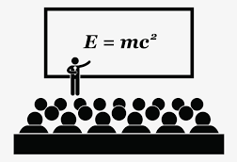


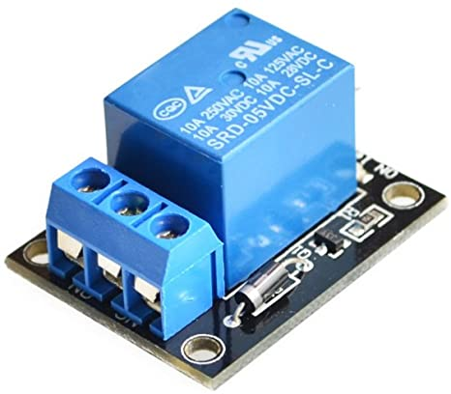
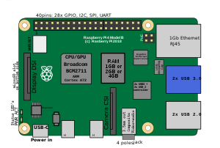

Block Diagram - 1 :
Imutils Library
Frames
CAMERA
CLASSROOM
RELAY
Programmed
YOLO ML ALGORITHM
BULB

Slide 12
Block Diagram-1 Explanation :
In this system we will be placing a 180 degree camera in the room .
The video output of the camera is splitted into frames using imutils library .
The frames are then fed to the Deep Learning Model trained on YOLO Algorithm which in turn detects the heads in images .
By detecting the heads in a particular frame , the electrical appliance connected to that frame will controlled accordingly using relay .

Slide 13
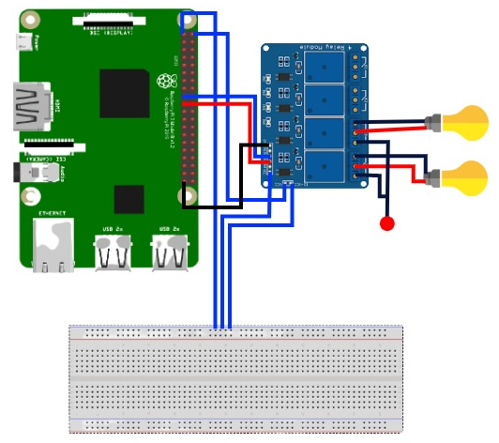
Circuit Diagram

Slide 14

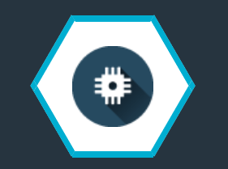

Block Diagram-2 :
PROGRAM :
Calculates the on time of electrical appliances
Energy Consumption = Ontime(hours/day) x power(W) /1000
Total Amount = Total Energy consumption x cost per kwh
Programmed
WEB UI / DASHBOARD
IBM CLOUD
IBM WATSON IOT PLATFORM

Slide 15
Block Diagram-2 Explanation :
In this system we will be calculating Total Energy Consumption and Total Cost of every electrical appliances
In the cloud based web app we will be total energy consumption and total cost per day by consolidating the energy consumption of all the electrical appliances .
We will be also displaying the total cost and total energy consumption for every month in the web application .
By this user can monitor the energy consumption for every day and every month .

Slide 16
Calculation
To calculate Energy Consumption per day
Electrical Appliance (Fan) = 70 Watts
Formula : E(Kwh) = Power(W) x time(hours/day) / 1000
Energy consumption = 70 x 8 hours /1000 = 0.56Kwh per day
Energy consumption per month = 0.56 x 30 = 16.8Kwh per month
Assume Rs1 per Kw
Total cost per month = Rs 16.8

Slide 17
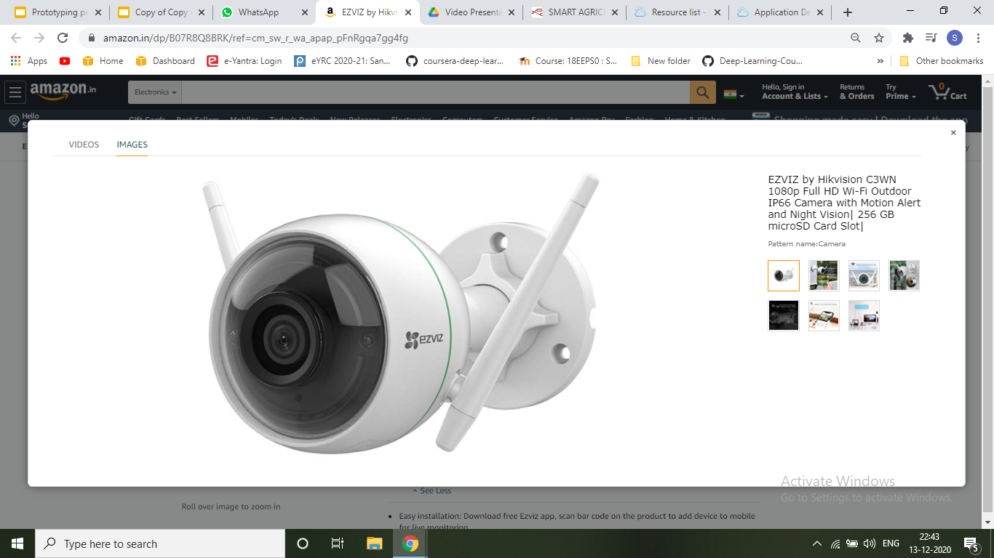
Camera Specification
Ezviz Full HD WiFi Wireless IP Security Camera CCTV
2 MP Ultra HD 1080P 8X Zoom
Night Vision Model: F1-362B.
Smart H.264 video encoding for smooth HD streaming even with low internet speed.
ULTRA HD 1080P: Stunning video quality with auto video enhance feature for crisp & clear image.
Water Proof

Slide 18

Implementation
As our camera notices people near fan and lights, it sends information regarding the position and span of people. Then the microprocessor decides which fan and lights should be switched on.
The fans and ambient lights are switched on until people are present near them

Slide 19
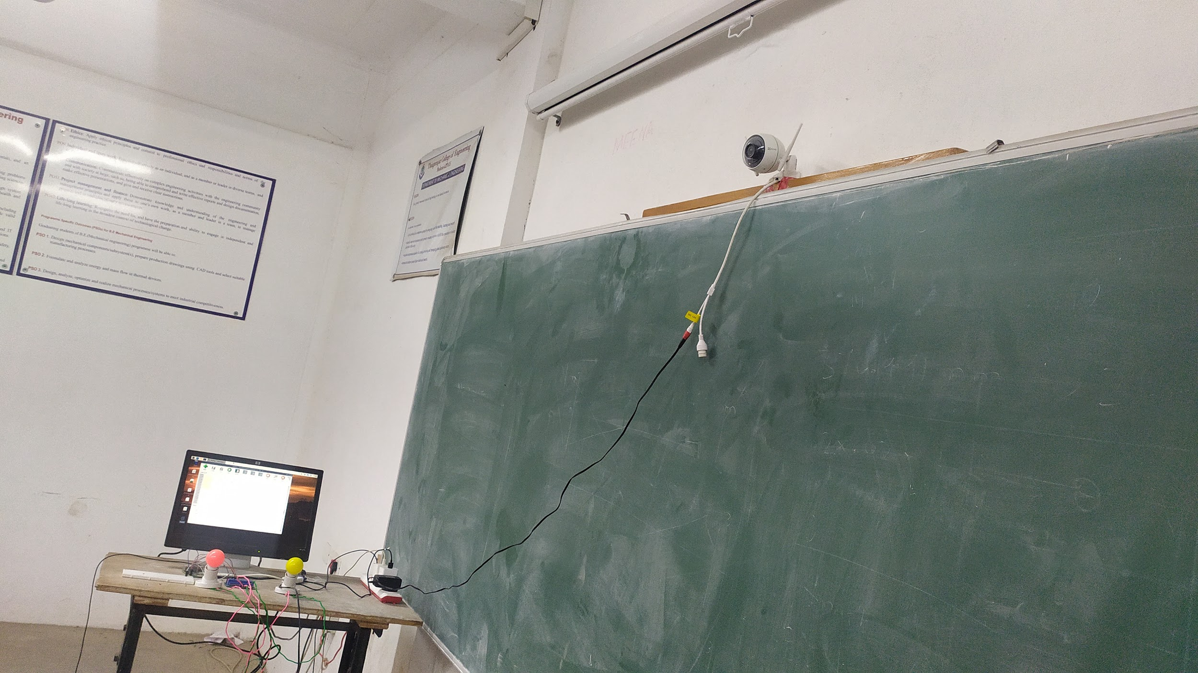
Placement of Camera in classroom

Slide 20
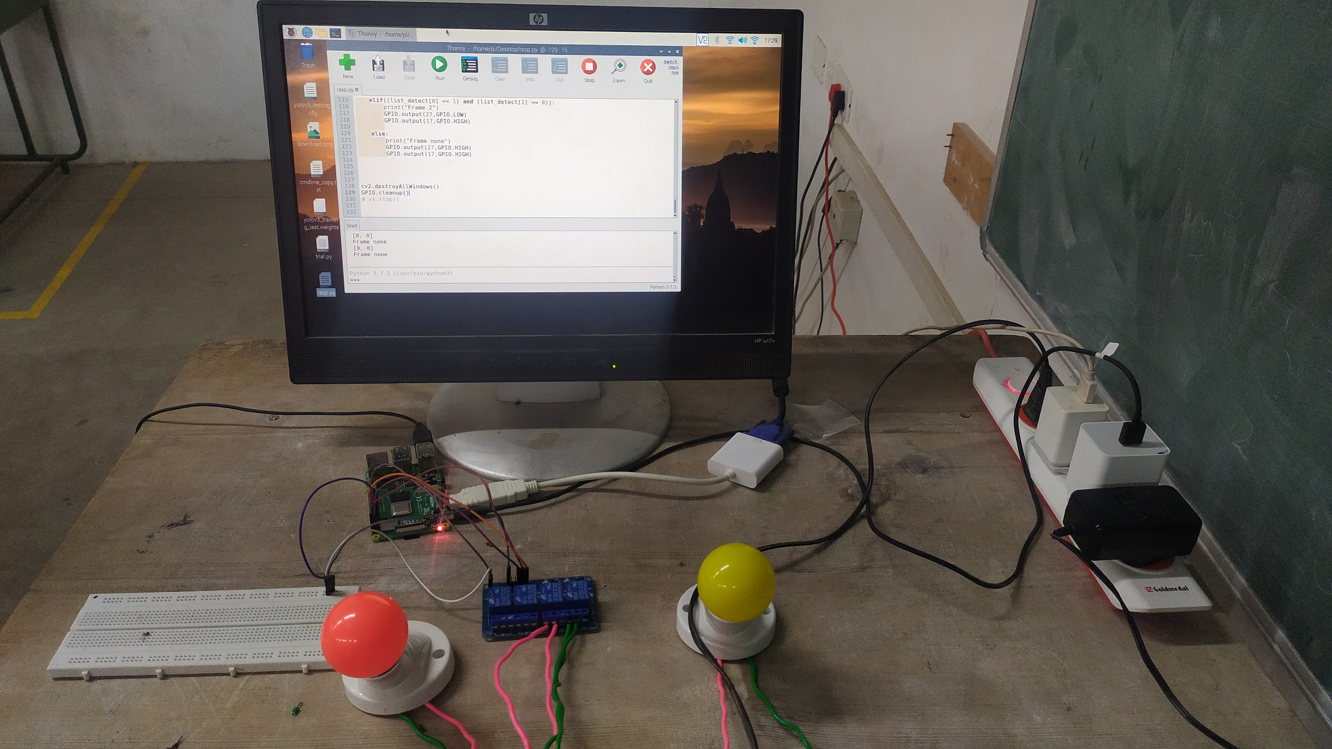
Components

Slide 21
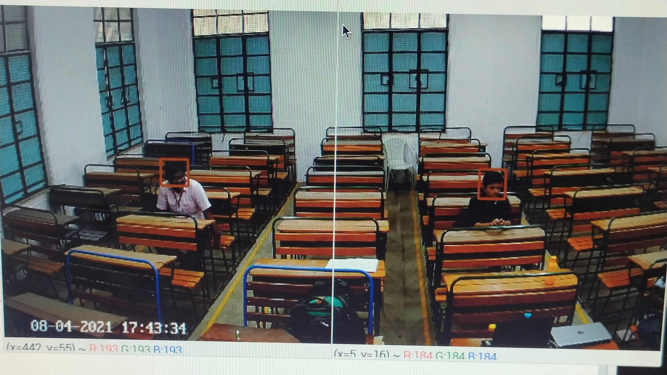
Head Detection

Slide 22
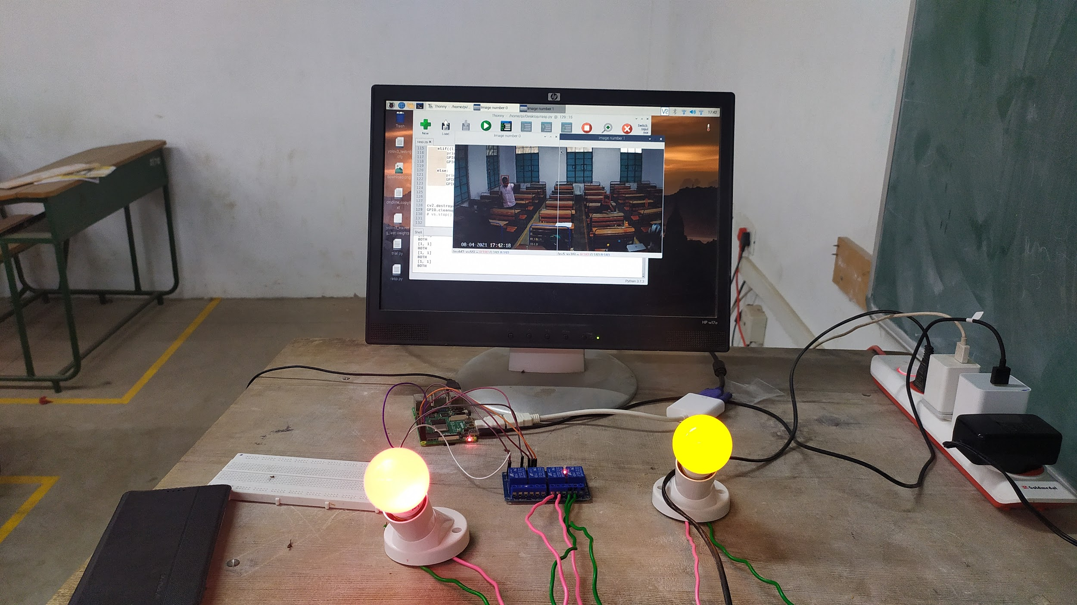
Working Relay and Bulb

Slide 23
Video Demonstration
LINK TO ACCESS VIDEO :
https://drive.google.com/file/d/16HkhcuRMM3GSzQLhPEmevNY3IQHDBfeZ/view?usp=sharing

Slide 24
Budget
SNO | Materials & Specification | Quantity | Cost(Rs)
1 | 2MP CMOS Ultra HD 1080P 8X Zoom , Night Vision wifi enabled | 1 | 4000
2 | Robonics 5V 2 CHANNEL SOLID STATE RELAY MODULE 240V 2A OUTPUT WITH RESISTIVE FUSE | 1 | 353
3 | Raspberry pi 4 , 4 gb Ram | 1 | 4085
4 | Bulb with socket cord | 1 | 300
TOTAL |  |  | 8738

Slide 25
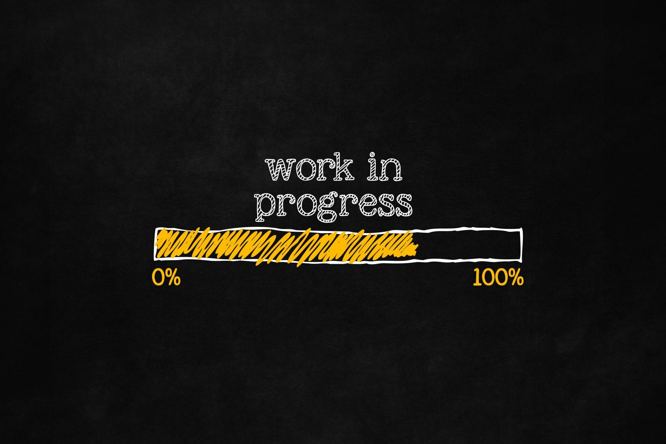
Progress
01
Required Components are brought
02
Head detection algorithm integrated with raspberry pi , relay and bulb
03
Fully working model is shown
04
WEB APP - Yet to be completed

Slide 26
Project timeline
Week 1
Week 2
Week 3 -4
Week 5
Software Designing
Software Implementation and checking
Hardware Designing and Implementation
Reviewing of the model , Sorting out the error and Final Implementation

Slide 27
Conclusion
In this fast pace World, Electricity demand is increasing exponentially. On Forecasting the future demand, we need more resources to run the world. Hence it is necessary to Save Electricity to large extent. We hope that our product E-Conserve may contribute to this vision.

Slide 28
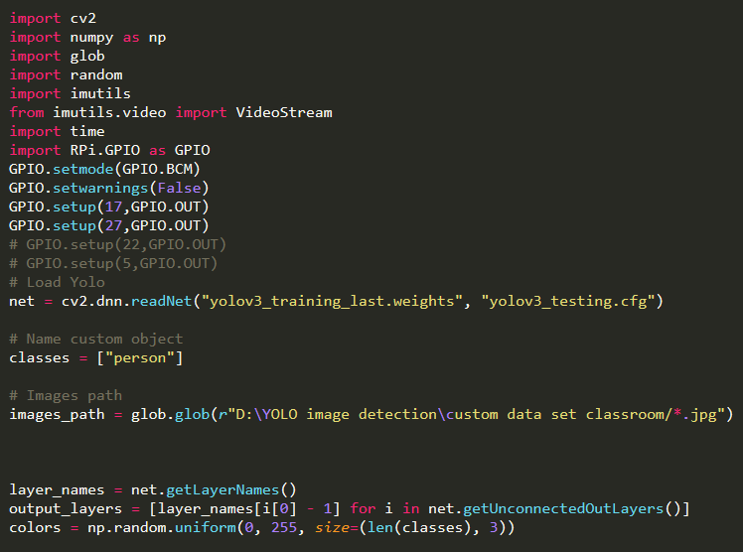
Appendix : Code

Slide 29
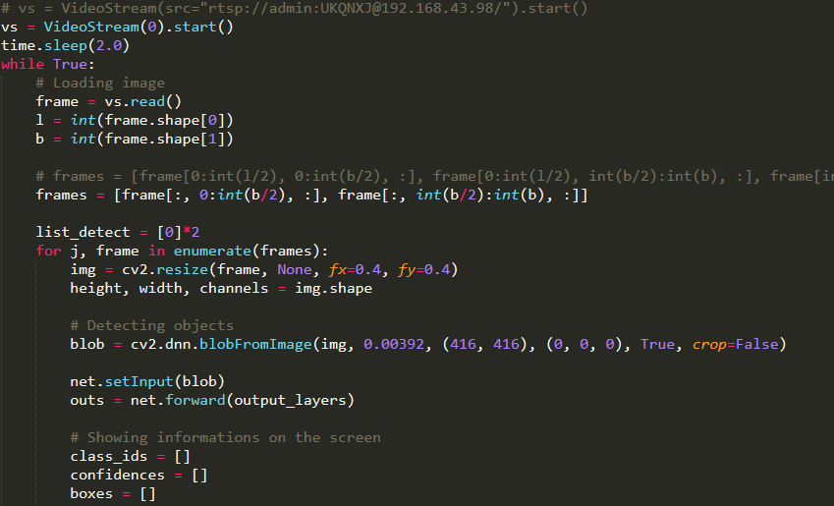
Appendix : Code

Slide 30
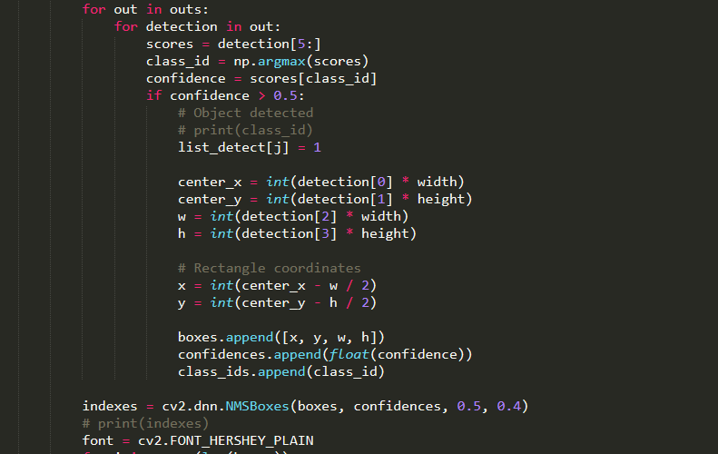
Appendix : Code

Slide 31
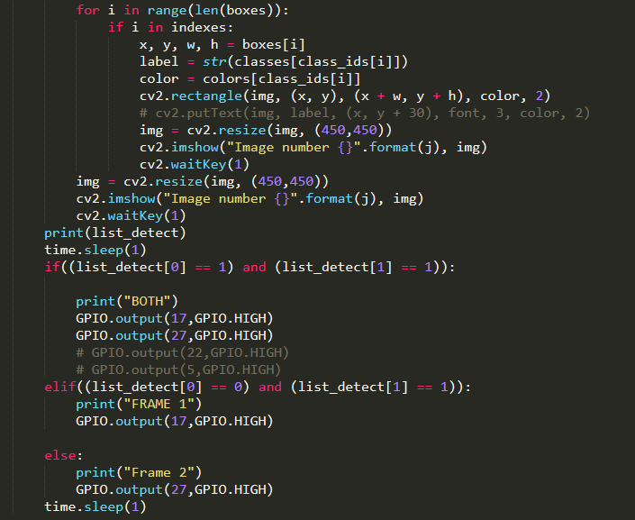
Appendix : Code

Slide 32
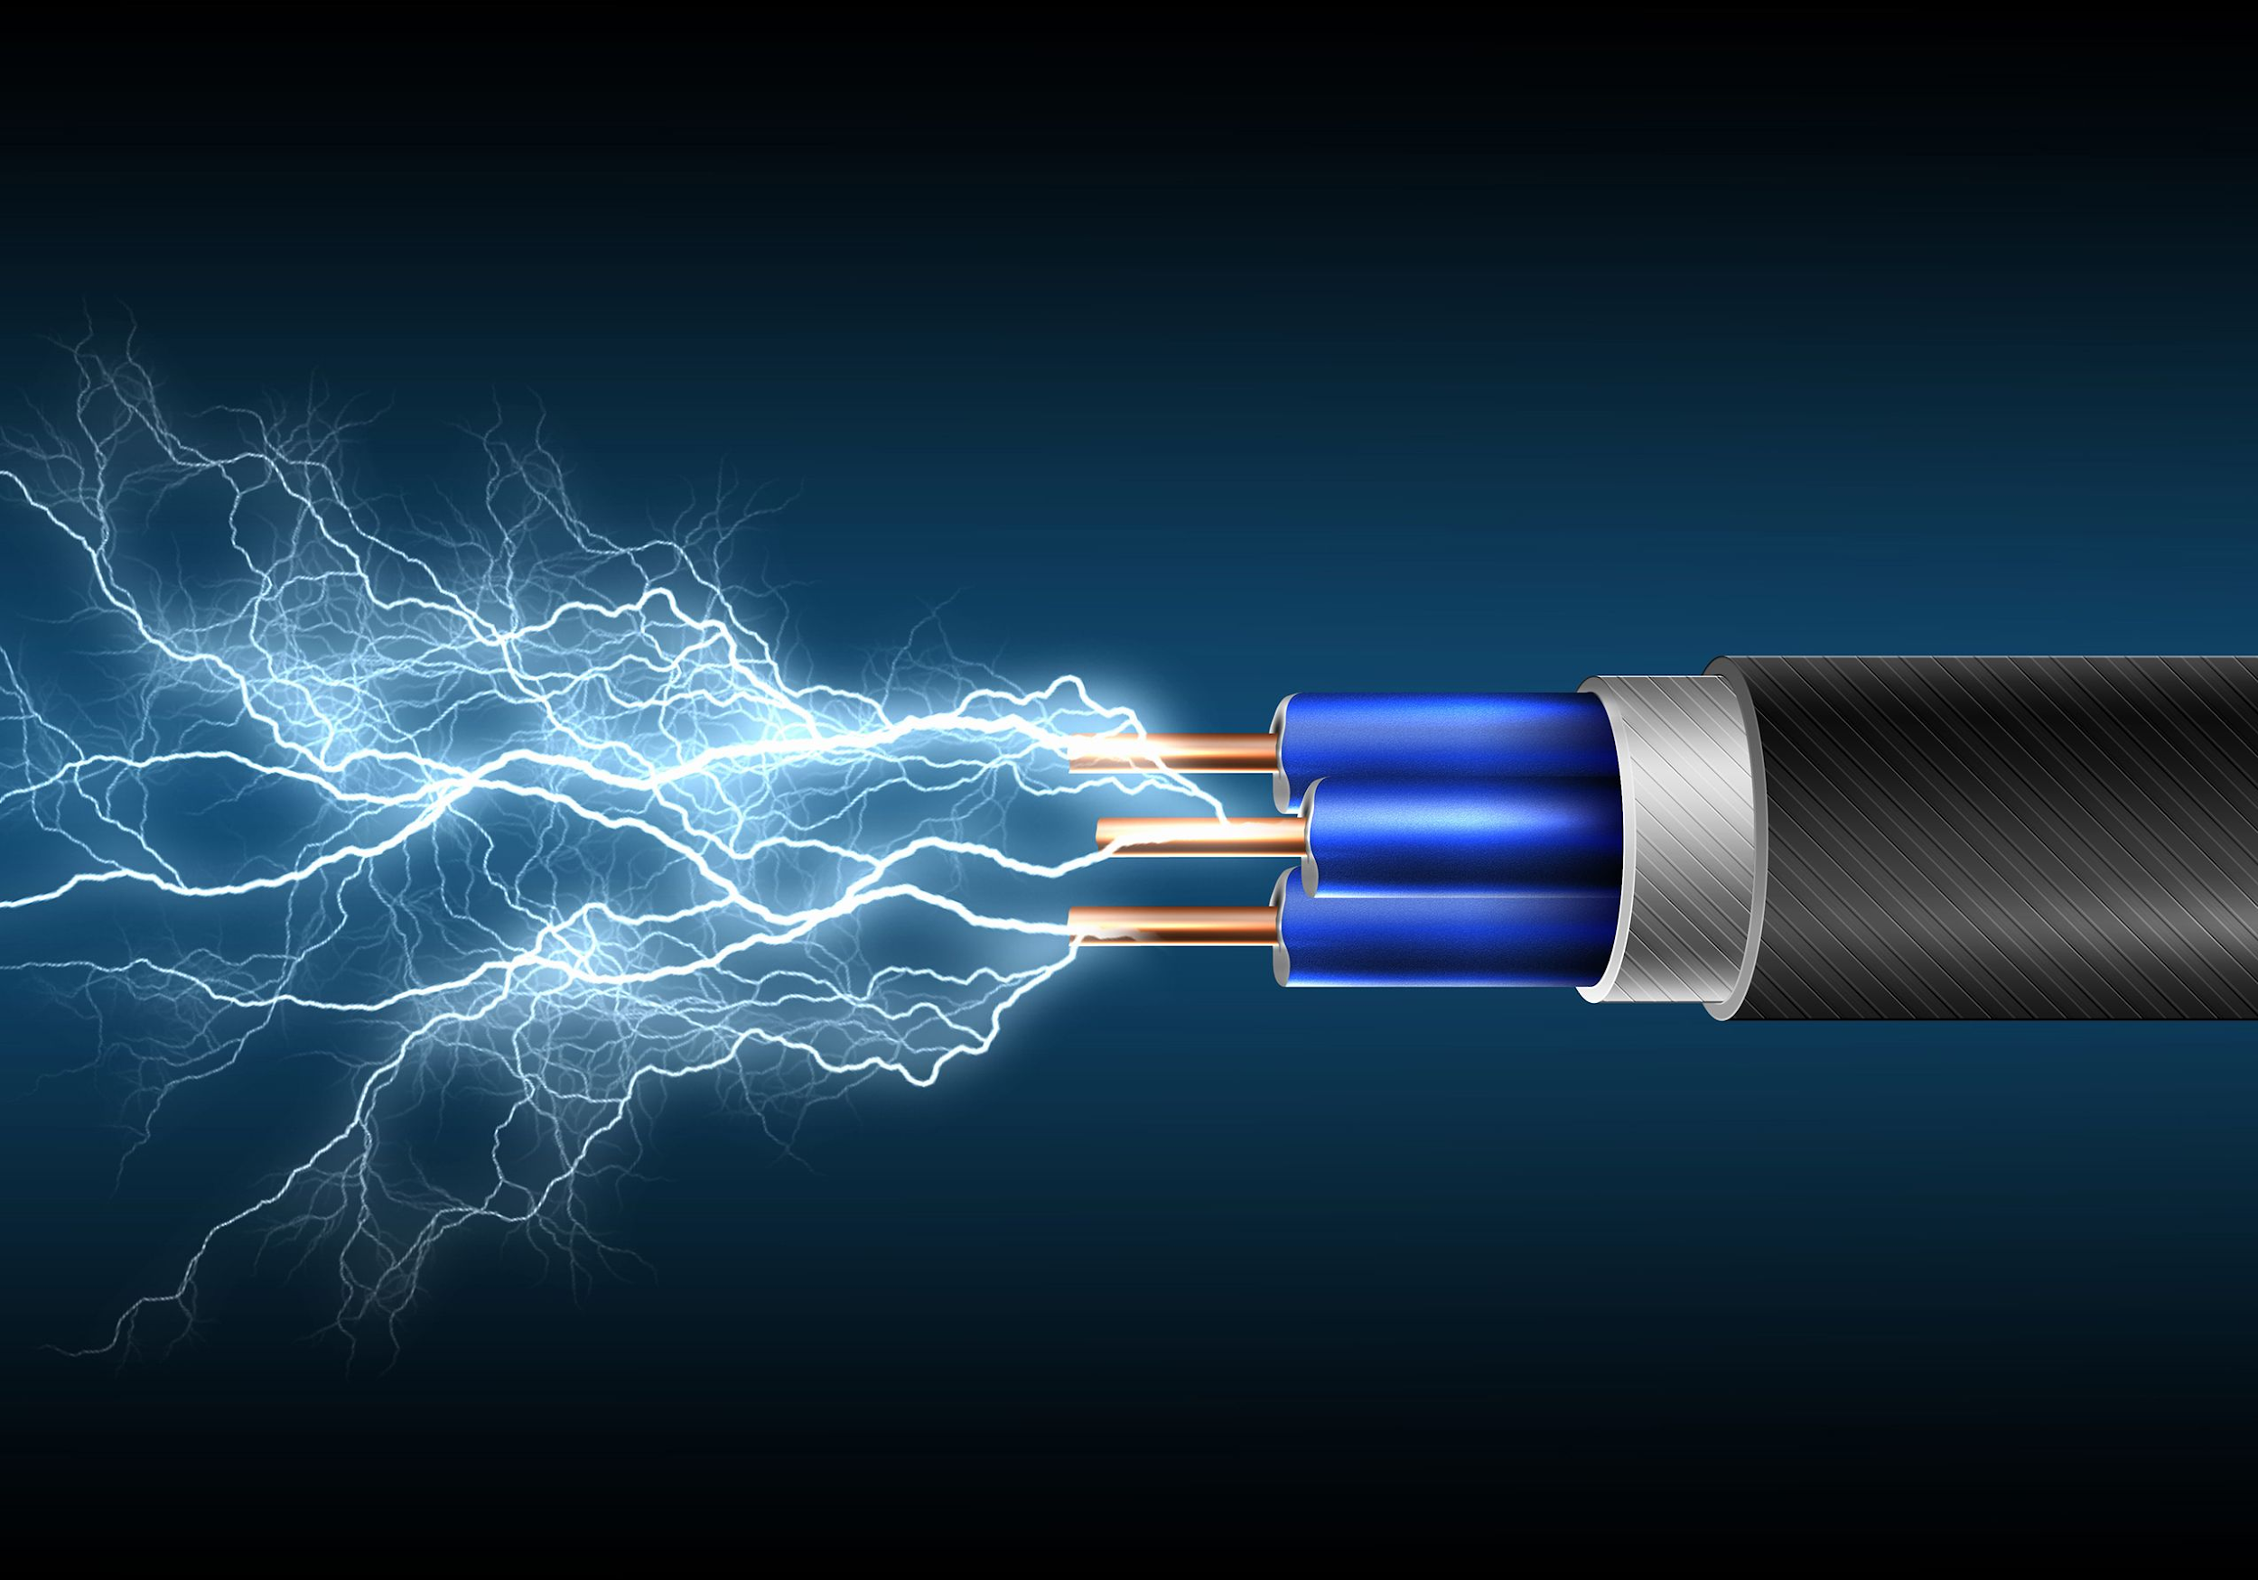
Thank you!

